Slide 1
Utimaco
Innovating Hardware Security Modules Through Implementing Machine Learning Algorithms and Predict Usage Patterns
Notes:
Hi everyone, the team is presenting our solution for Utimaco to innovate hardware security modules through implementation of machine learning algorithms to predict usage patterns.

Slide 2

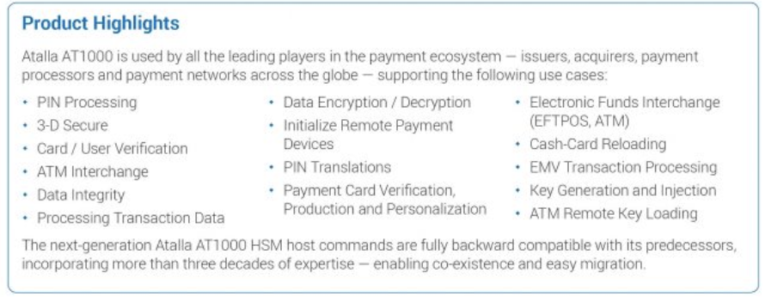

HSM Overview
Encrypt and decrypt information, as well as manage digital keys
Highly secure solution to protect non-public data for:
payment information (credit card transactions)
customer or employee data
valuable business information
Hardware connected to host applications to store data
Introduction ----- Problem ----- Solution ----- Models ----- Learning Path
Notes:
Michael
Bullet #1: In a world where businesses are collecting exponentially increasing amounts of data, this product is becoming more widely used to ensure customer data is safely stored
This product is used to encrypt and decrypt information as well as manage digital keys. This device is essential for the banking industry, for example atms would use this to keep customer information secure.

Slide 3
Product & Problem Statement
Product — u.trust360:
Unreleased HSM product from Utimaco
Software to monitoring and provision multiple Atalla AT1000 HSM appliances
Business model: subscription
Buying HSM’s to store certain amounts of data
Problem:
Predicting CPU usage over time
Notifying users of potential time for reaching 80%, 90%, full capacity.
Reminding clients to upgrade plan to maintain health of HSM infrastructure
Example: Commercial Banking
Introduction ----- Problem ----- Solution ----- Models ----- Learning Path
Notes:
Anh-Tu
So our product is u.trust360. For example, let’s say our client is a large commercial bank. Let’s assume they need 4 HSM’s, each one stores 10,000 transactions per second, so in total 40000 transactions per second to manage/encrypt all the transactions for their ATM networks. The client would purchase 8 HSM’s, 4 in one datacenter and a another 4 in another data center. This gives them redundancy in case one datacenter fails. Secondly (this is where you & u.trust360 comes in), in peak periods (Say prior to Thanksgiving), instead of 40K they might need 45K TPS just for a few hours. But they aren’t sure, because peak periods are hard to measure. So in order to be ready, they buy 4 more HSM’s, and divide 2 at each datacenter (so 6 in each location). Now the bank has 12 HSM’s in 2 datacenters, when they originally needed 4.

Slide 4
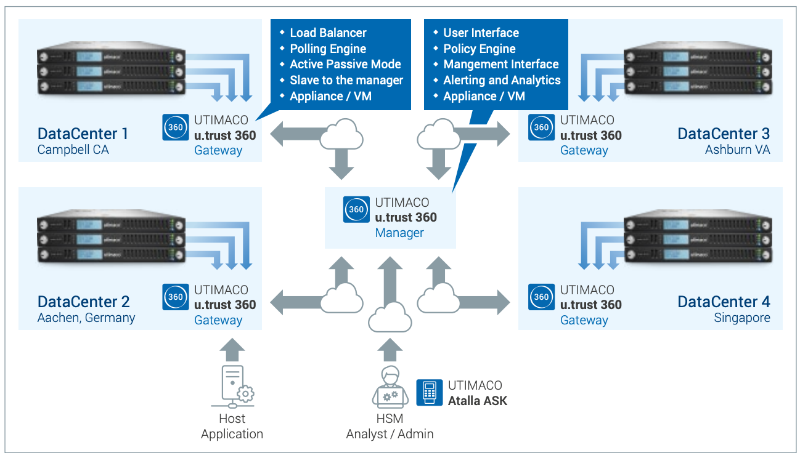
Introduction ----- Problem ----- Solution ----- Models ----- Learning Path
Notes:
Anh-Tu
This graphic shows utrust360’s product ecosystem where host applications are connected to Utimaco’s product gateway and would store the data centers in different locations around the world.

Slide 5

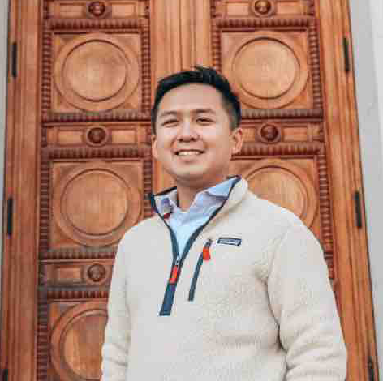


The Team
Michael Deal BA Economics
Anh-Tu Lu
BA Operations Research & Management Science
Robin Yoo
BA Data Science
BA Statistic
Lawrence Chang
BA Mathematics
BA Statistic
Notes:
All of us

Slide 6
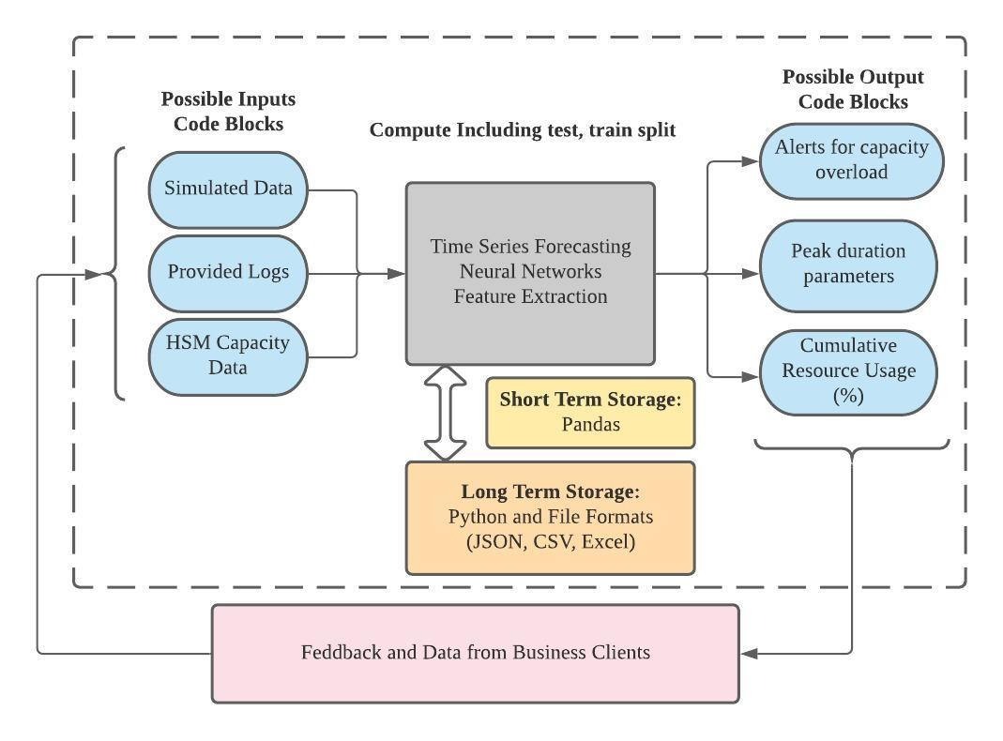

Solution System Architecture
Introduction ----- Problem ----- Solution ----- Models ----- Learning Path
Notes:
Anh-Tu
For our solution architecture, we’re inputting HSM Capacity Data like CPU usage into time series forecasting models to predict future usage that alerts for capacity overload.

Slide 7
Approach
Data Cleaning
Presentation
Cleaned data to remove inconsistencies & created visualizations
Choose best fit model and present findings
1
2
3
4
Finding Data
Time Series Models
Find data on CPU utilization over certain periods of time. Utilized GitHub, Google Data, Kaggle
Implemented time series models on datasets and tested for RMSE
Introduction ----- Problem ----- Solution ----- Models ----- Learning Path
Notes:
Anh-Tu

Slide 8
Dataset
Initial Problems:
Sample data was not provided with product demo
Our Solution:
Researched time series CPU usage data from Github, Kaggle, Google Dataset Search
Source: https://github.com/alibaba/clusterdata/blob/master/cluster-trace-v2018/trace_2018.md
Introduction ----- Problem ----- Solution ----- Models ----- Learning Path
Notes:
Robin
Since the HSM is not published yet, we use the data set from Kaggle to generating the forceting model system.

Slide 9
Cleaning & Visualizations
The original data is about 9 GB.
Organized the data by Computer IDs and chose the one with the most massive amount of data points.
Removed all the NA and duplicated values.
Kept Timestamp (second) and CPU (%)
Introduction ----- Problem ----- Solution ----- Models ----- Learning Path
Notes:
Robin
The original data was about 9 GB. So we grouped by the id and chose 6 most amount of data set size and kept two major variables, Timestamp and CPU in percentage.

Slide 10
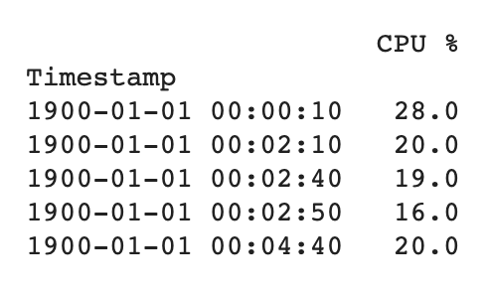
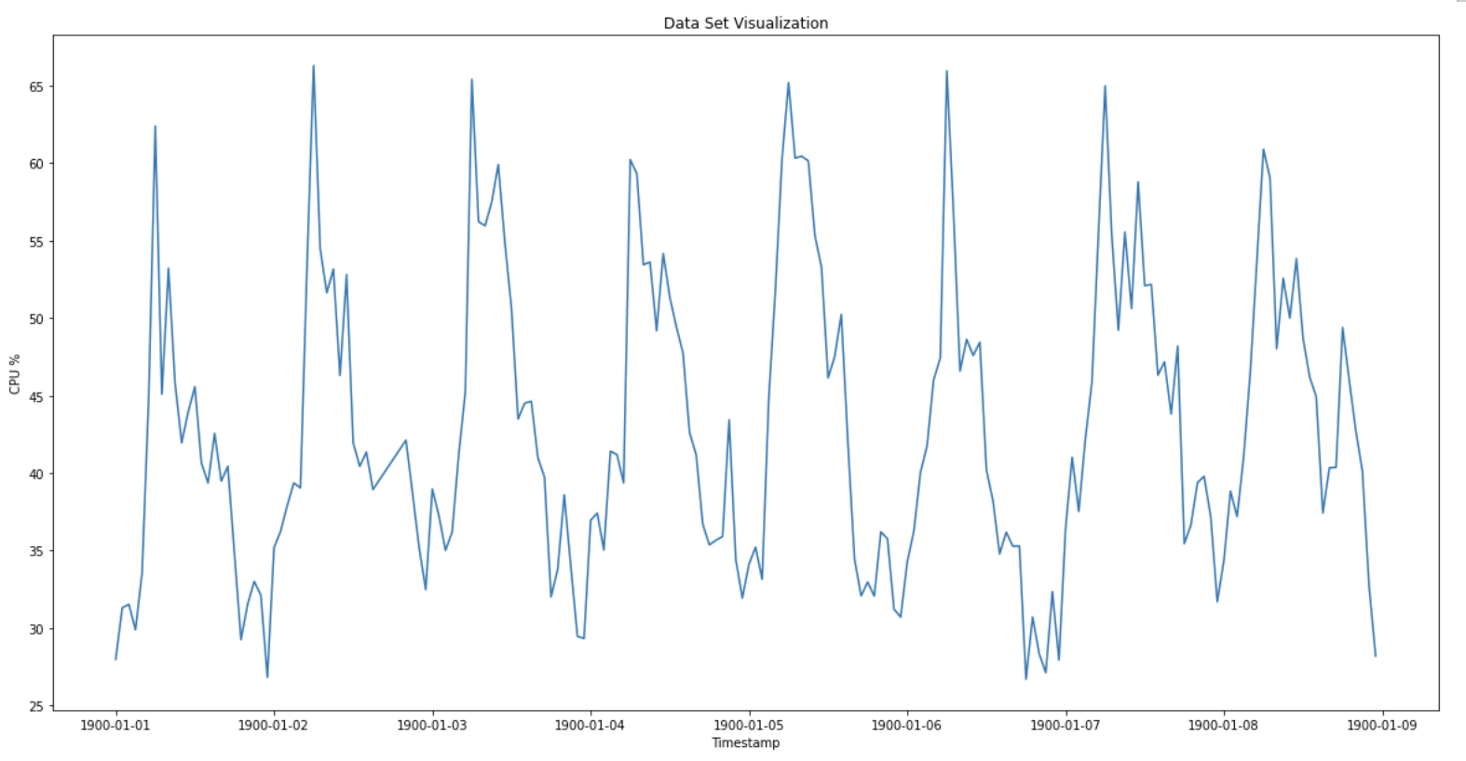
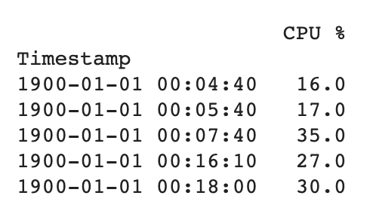
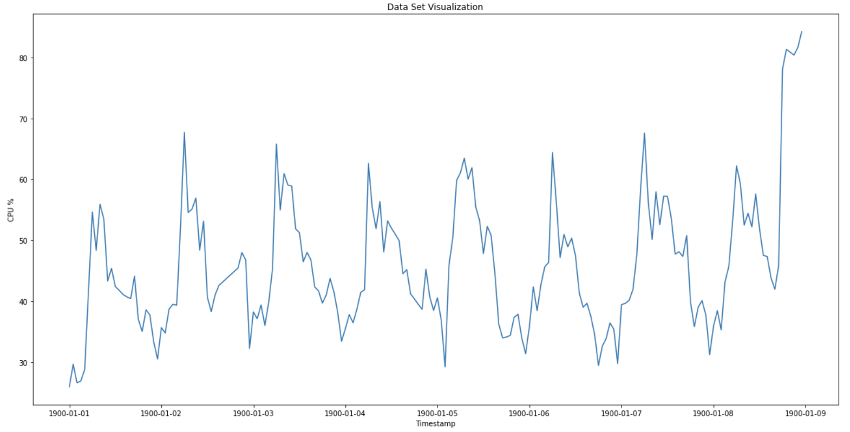
Dataset 1 and 2
Introduction ----- Problem ----- Solution ----- Models ----- Learning Path
Notes:
Robin
Skip fast

Slide 11
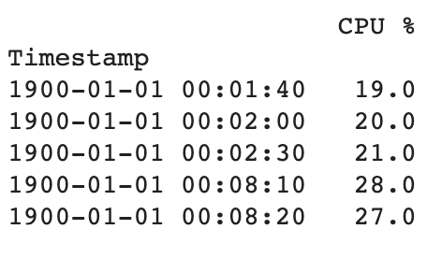
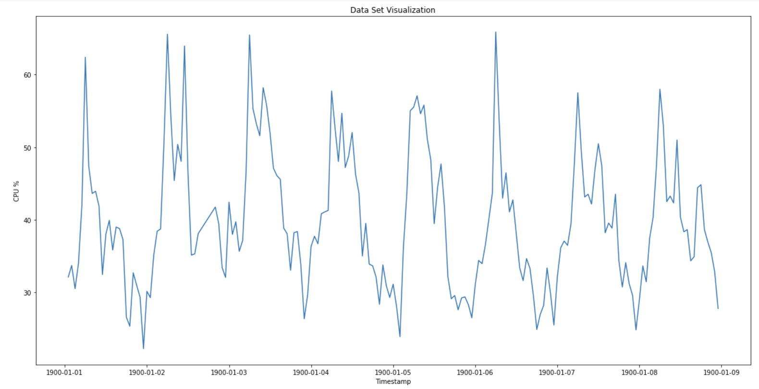
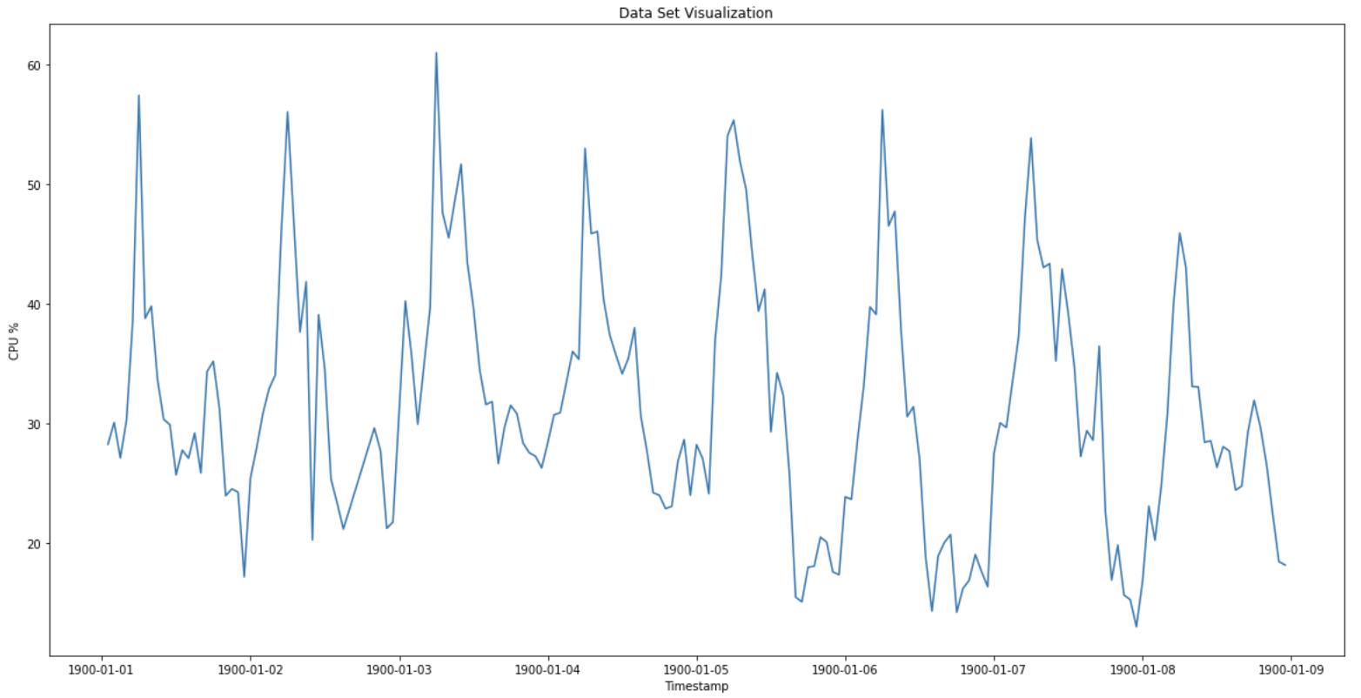
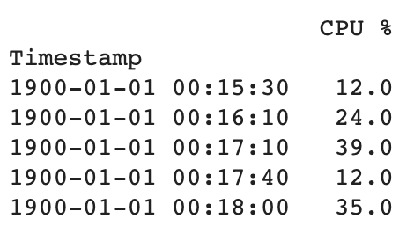
Dataset 3 and 4
Introduction ----- Problem ----- Solution ----- Models ----- Learning Path
Notes:
Robin
Skip fast

Slide 12
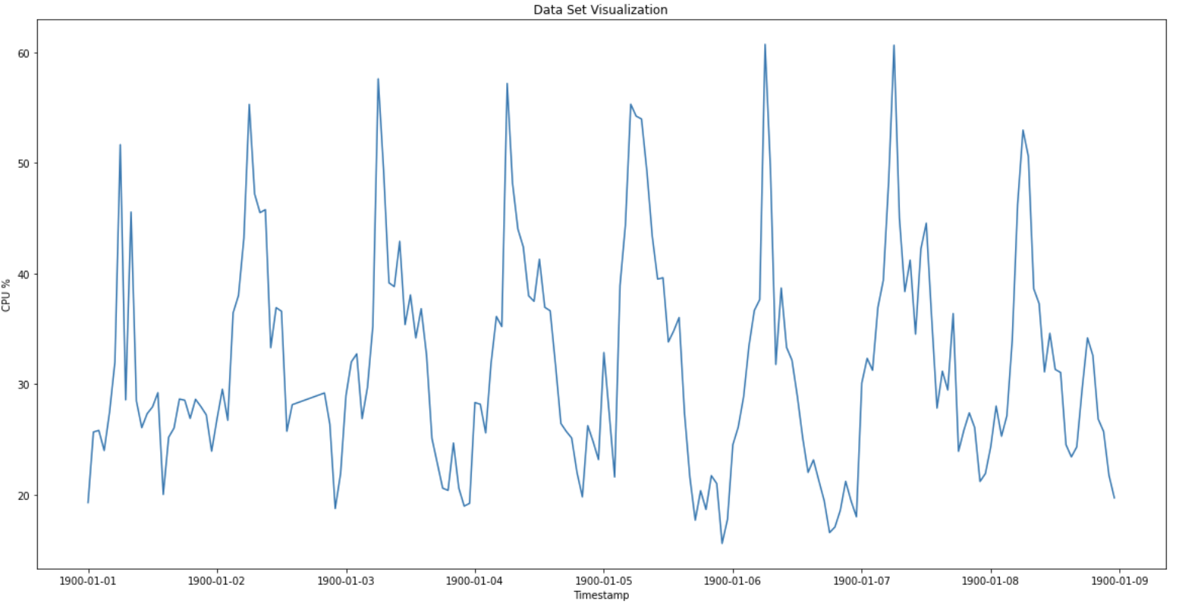
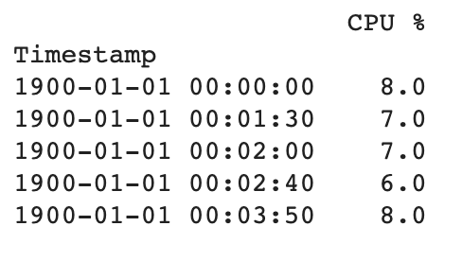
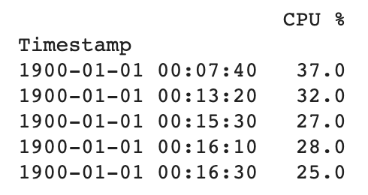
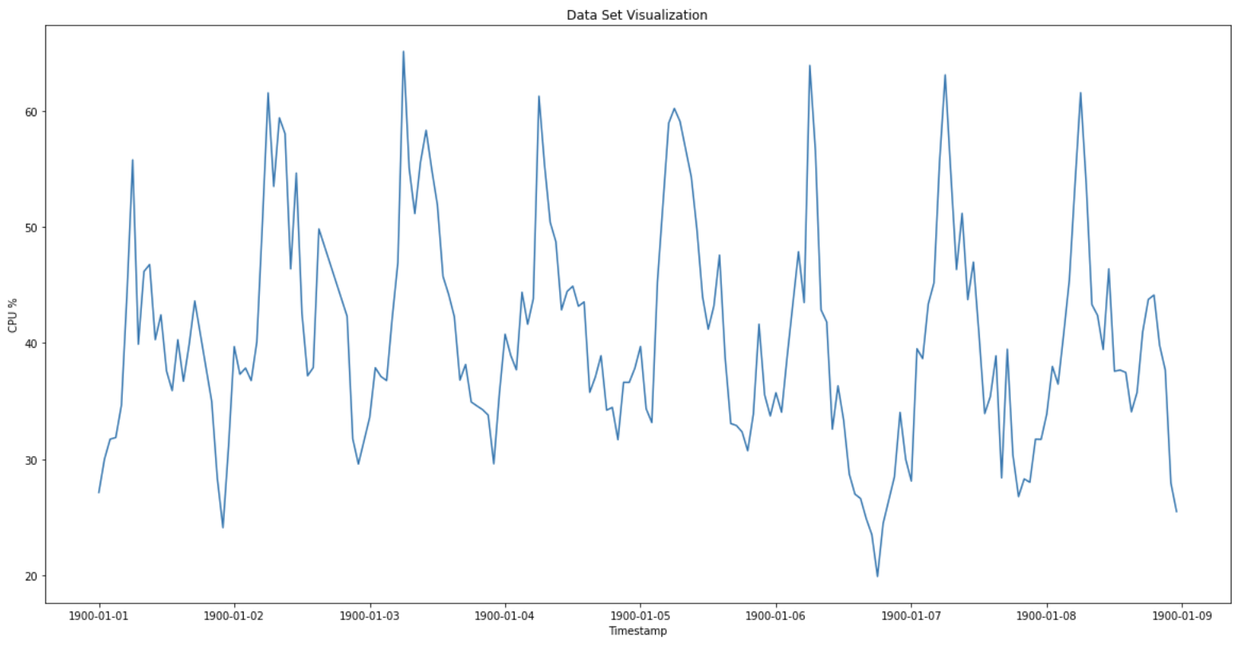
Dataset 5 and 6
Introduction ----- Problem ----- Solution ----- Models ----- Learning Path
Notes:
Robin
Skip fast

Slide 13
Time Series:
A time series dataset measures a quantity over time.
Time Series Features:
Seasonality & Trend
Seasonality is a pattern that repeats at equal time intervals (daily, weekly, monthly, etc.)
Trend is a long-term increase or decrease throughout the time series.
Holiday Spikes & Changing Trends
On top of seasonality and trend, there may be holiday spikes and the trend may change multiple times throughout the dataset.
Introduction ----- Problem ----- Solution ----- Models ----- Learning Path
Notes:
Robin
Time Series are used to forecast some measured quantity at points in the future.
Time series divides into three different categories considering seasonality, trend, holiday and changing trends.
Considering our current and future data sets, our models are generated with seasonality and trend and complex models categories

Slide 14
Time Series:
Seasonality & Trend
Triple Exponential Smoothing (Holt-Winter)
Sums level, trends, and seasonality components where each component is a weighted average with weights that increase exponentially with time.
SARIMA
Fits a regression model on previous observations, error terms, and differencing, and adds terms to account for the seasonal components.
Introduction ----- Problem ----- Solution ----- Models ----- Learning Path
Notes:
Robin
Triple exponential smoothing
The level, trend, and seasonality components are calculated recursively as in simple exponential smoothing
SARIMA
Allows observations from previous years to be added to the model
meaning if we are trying to forecast next December, SARIMA may use the value from the last few December observation and use historical December errors.
The key values for these two models are seasonality and trend

Slide 15
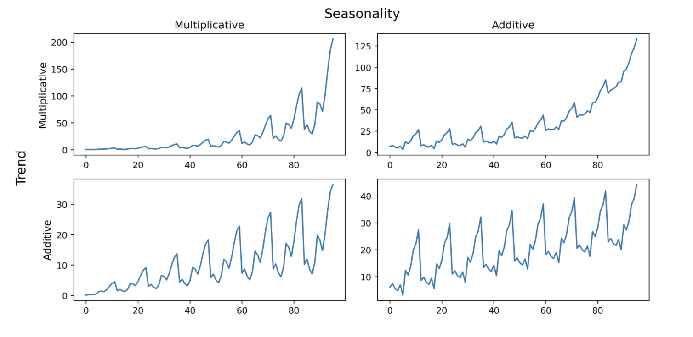
Types of Seasonality & Trend
Introduction ----- Problem ----- Solution ----- Models ----- Learning Path
Notes:
Robin
Here we can see that seasonality and trend can classified as additive or multiplicative.
The key graph we need to consider is bottom right graph, which is both additive seasonality and trend tred a

Slide 16
Original Datasets
Introduction ----- Problem ----- Solution ----- Models ----- Learning Path
Notes:
Robin
As it is shown in the original graph, both seasonality and trend is increasing and have similar patterns every 24 hours.

Slide 17
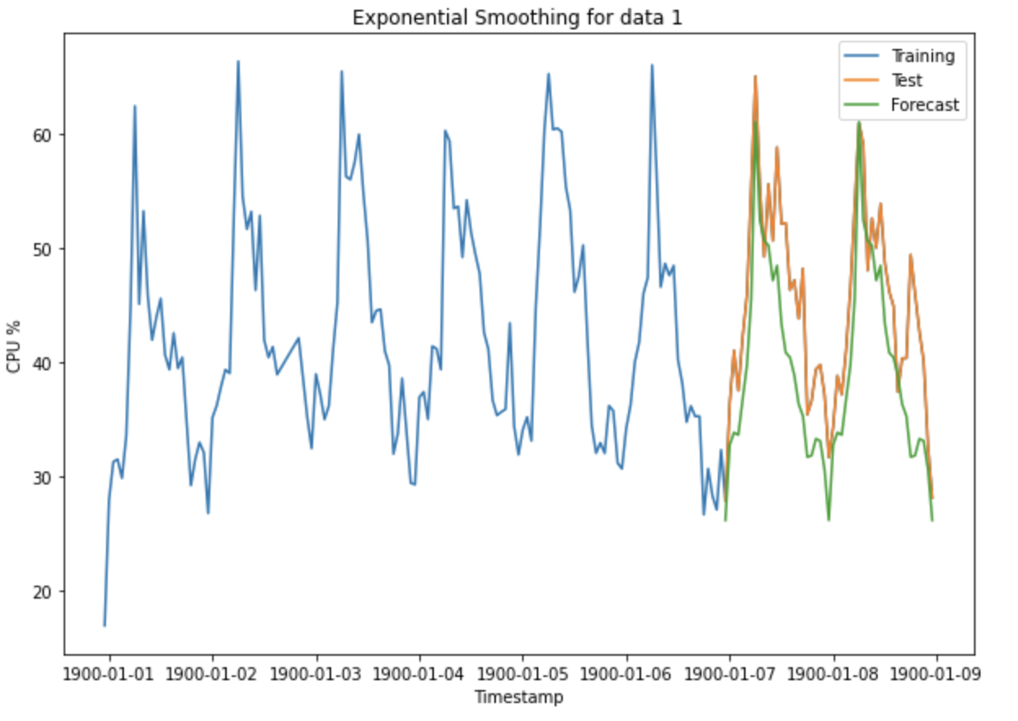
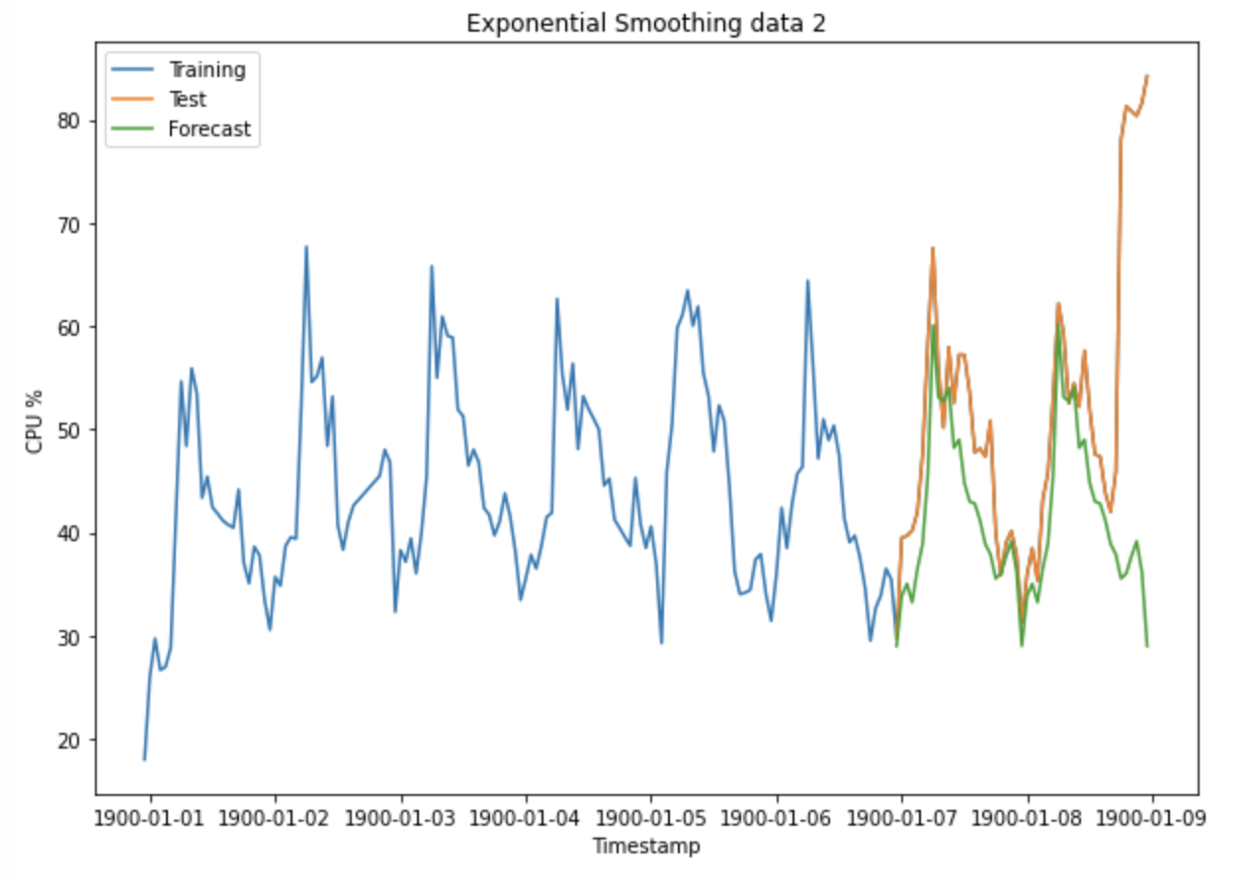
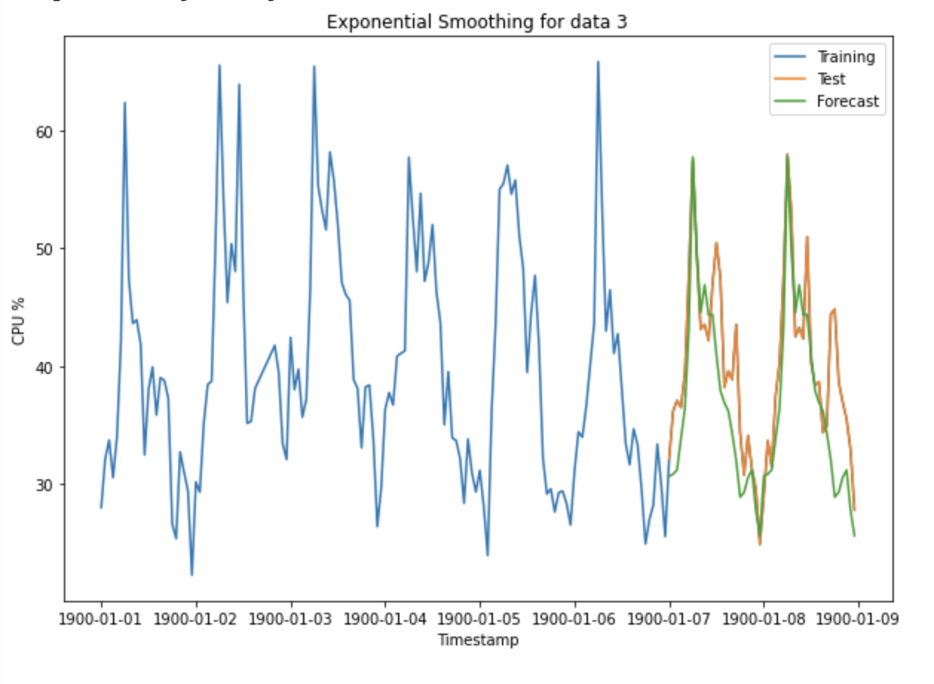
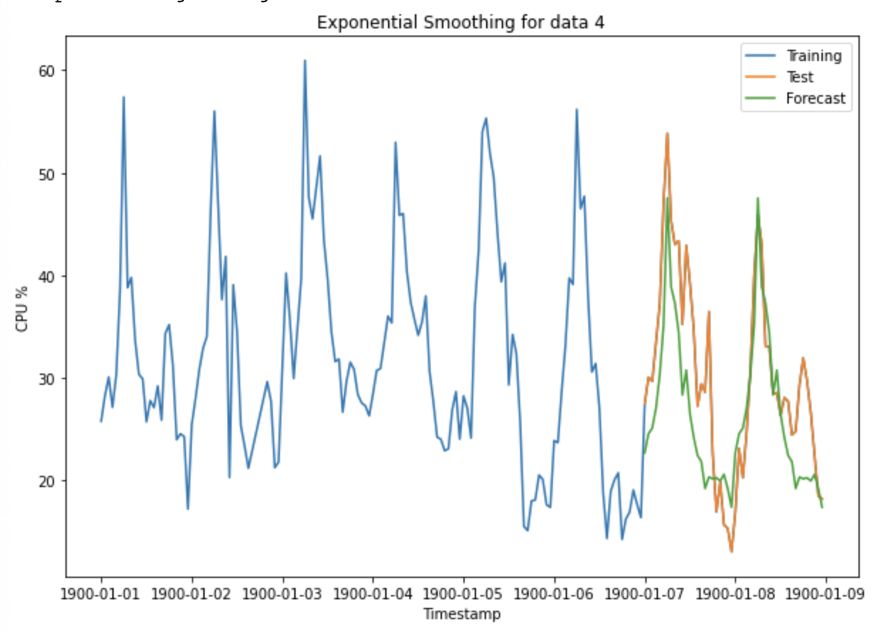
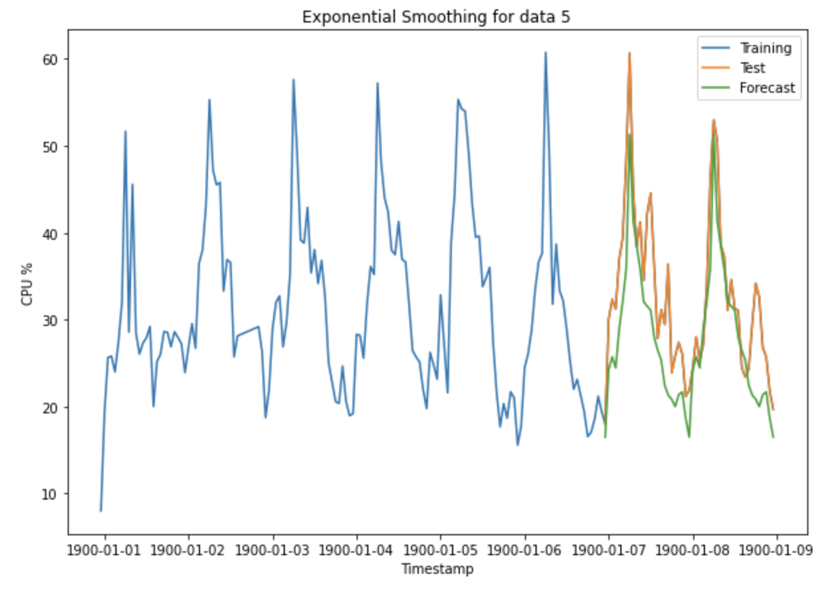
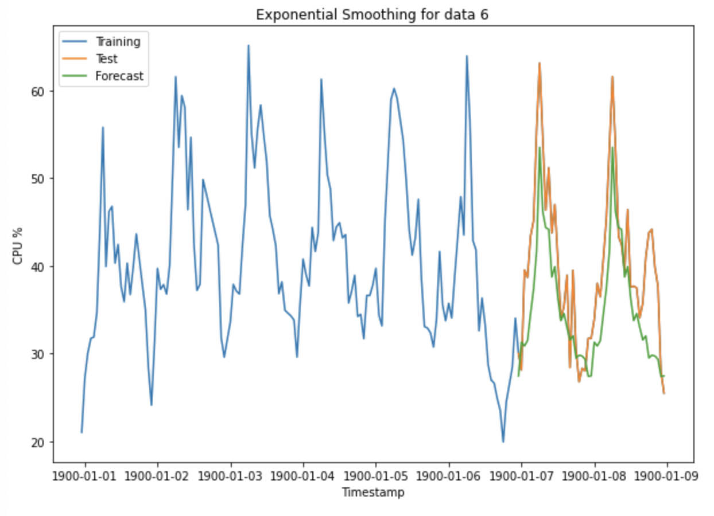
Holt-Winter
Introduction ----- Problem ----- Solution ----- Models ----- Learning Path
Notes:
Robin
Base on that information, we generated Holt-Winter as it shown in the slides.
Blue line represents the original data sets that we use for the training
Orange line as the test data sets where we will going to forcest (last 48 to 49 observation)
Green line as forecasted data based on training data sets.
As we can see the Orange line have very similar trend with green line which is good forecasting.

Slide 18
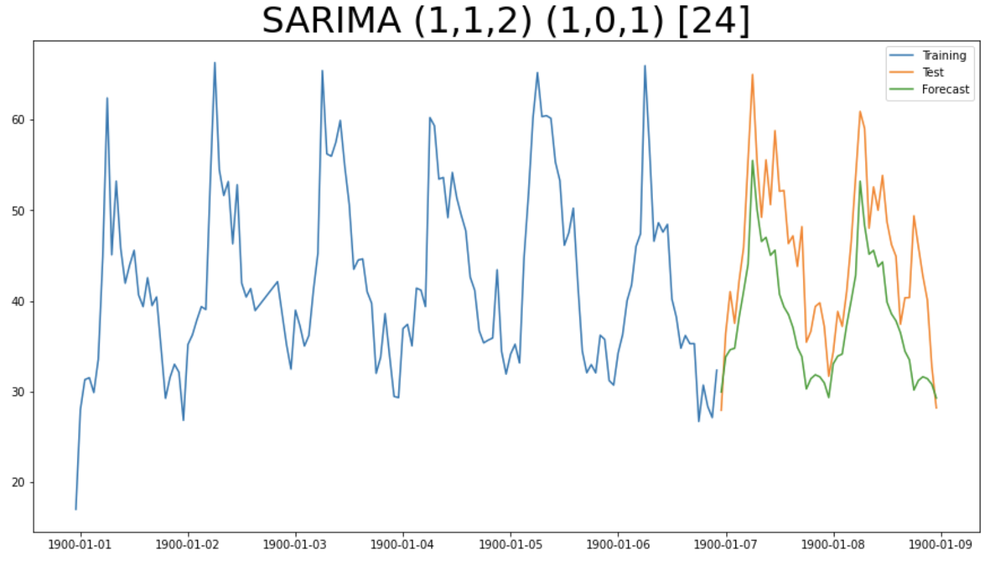
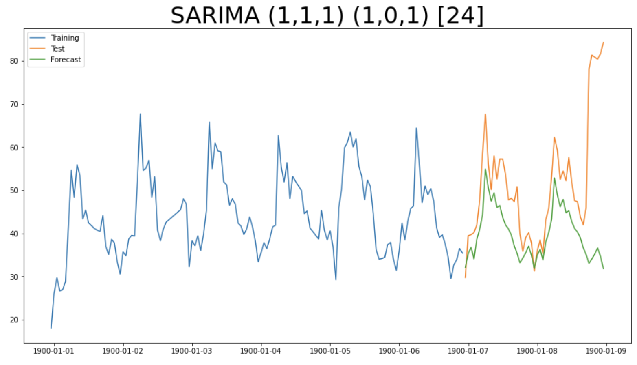
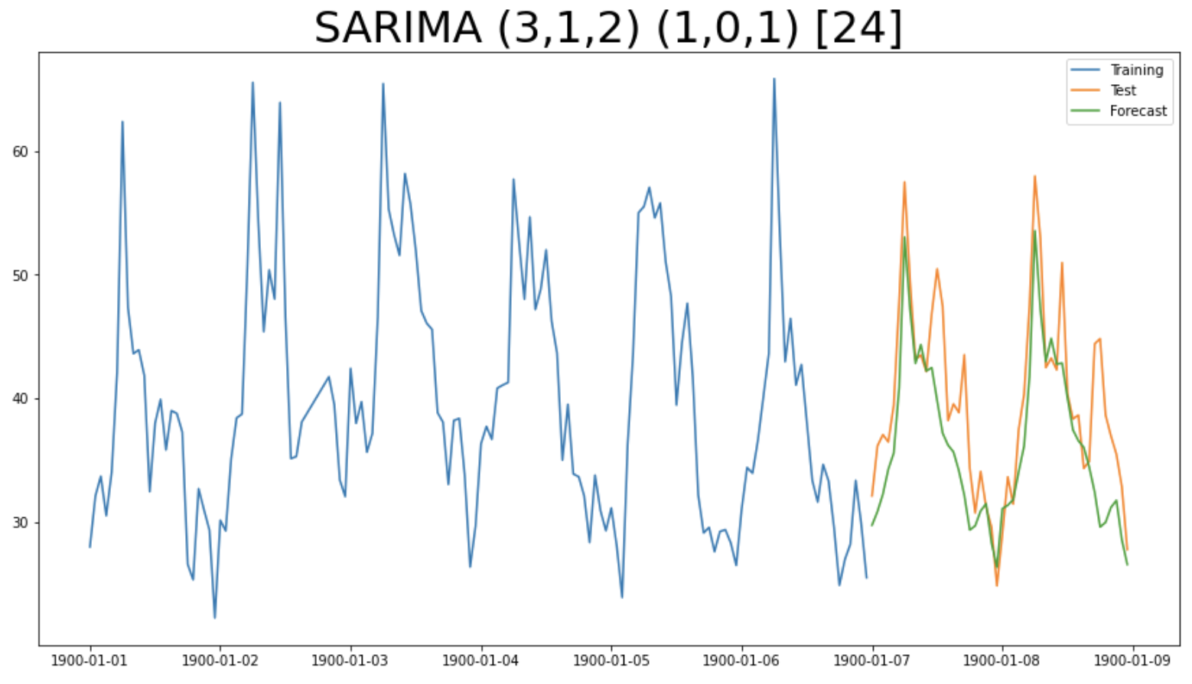
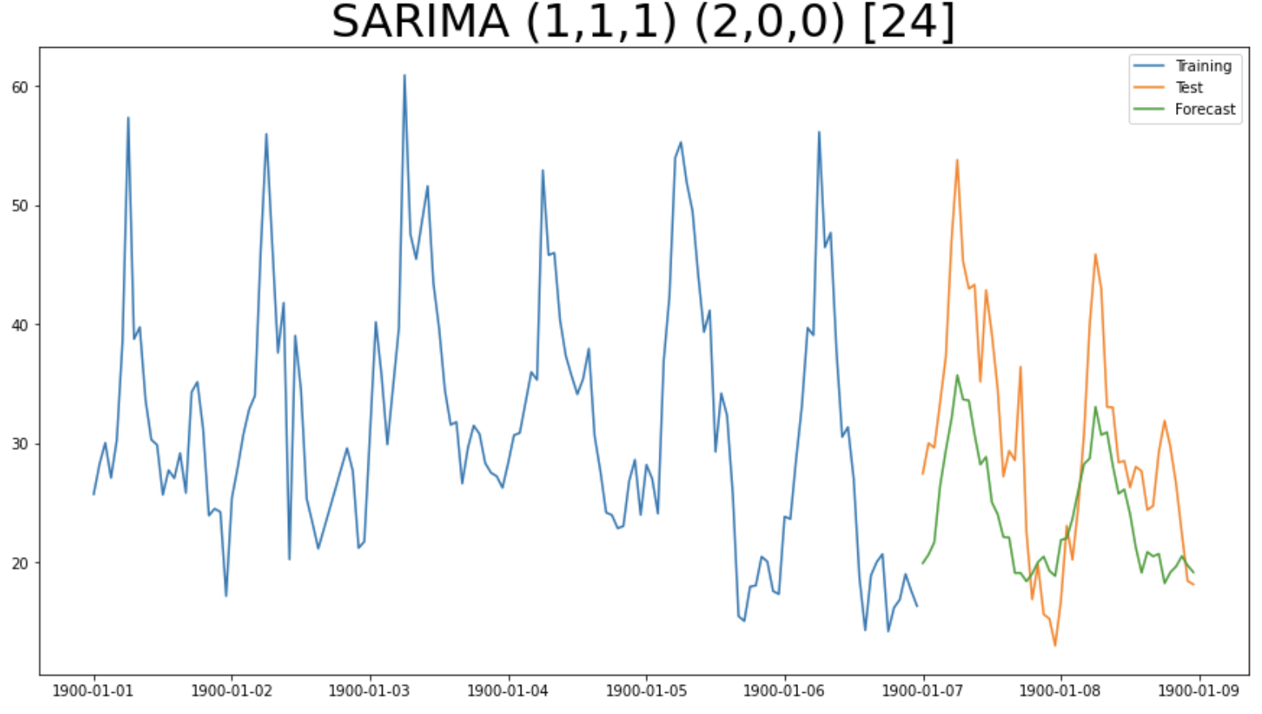
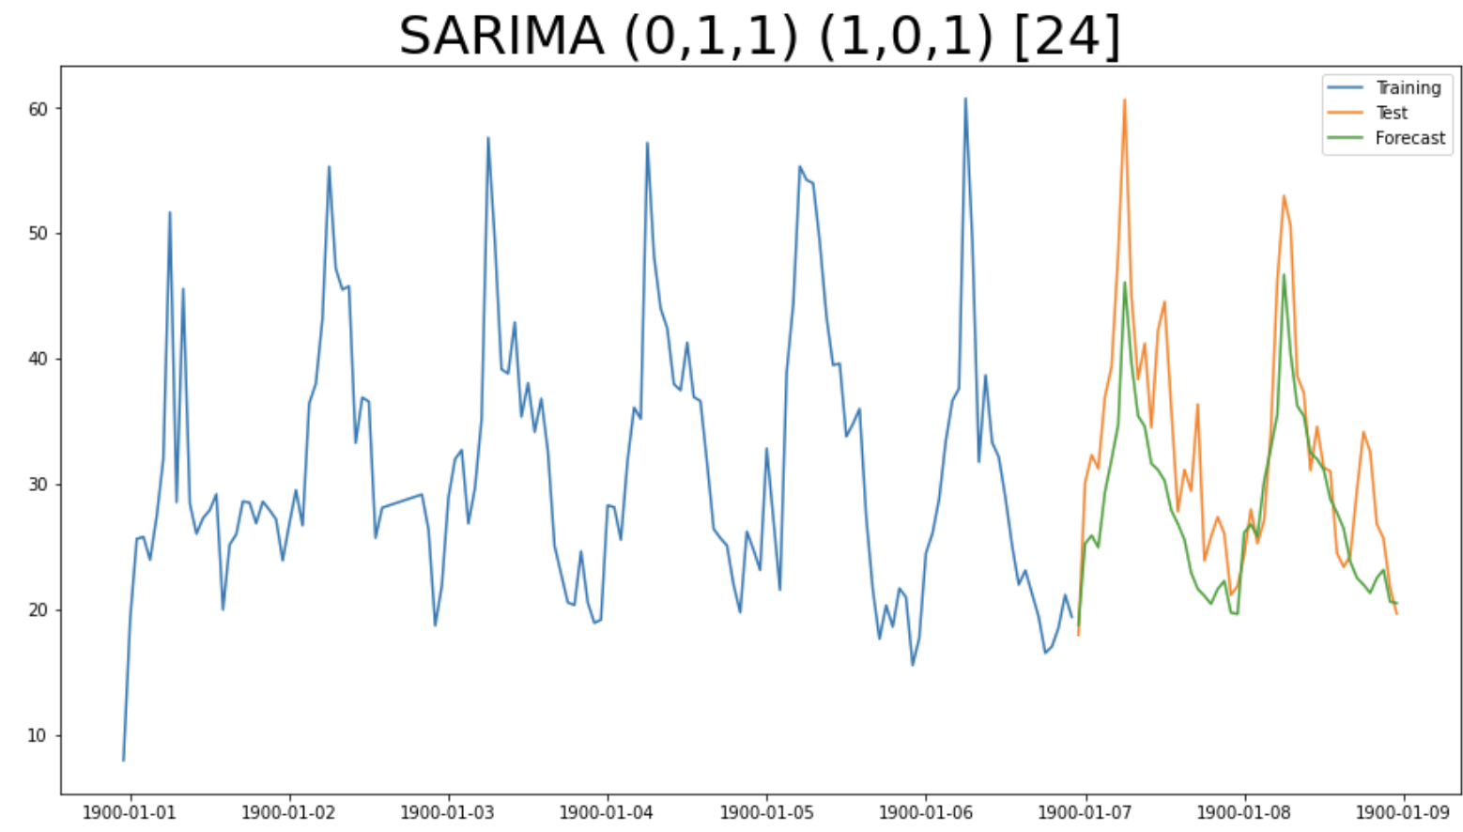
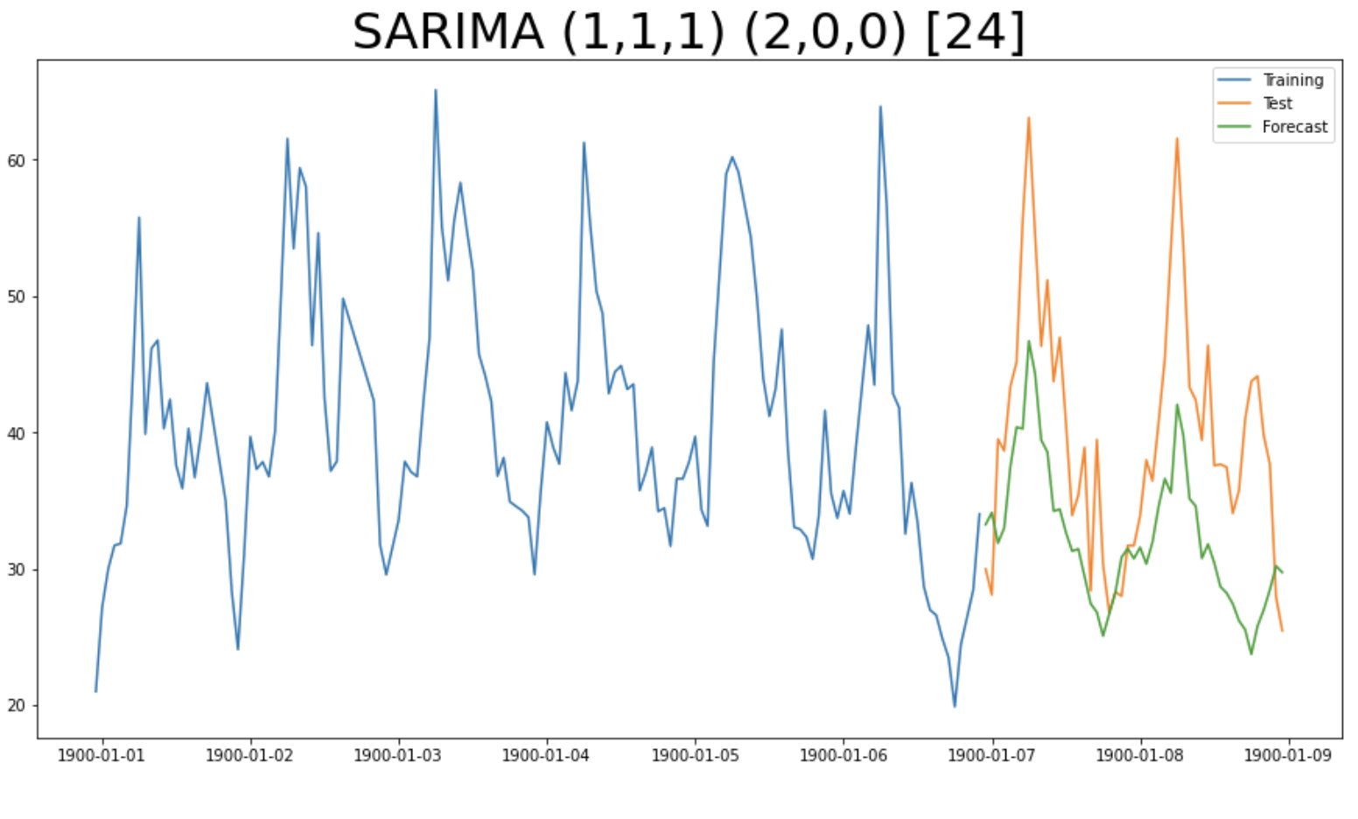
SARIMA
5
Introduction ----- Problem ----- Solution ----- Models ----- Learning Path
Notes:
Lawrence - fast

Slide 19
Time Series: Complex Model
Prophet (Facebook)
Built for high-frequency data with multiple seasonalities
Take into account special events and bank holidays
LSTM (Long Short Term Memory)
Part of Deep Learning, Recurrent Neural Network
Networks with loops in them, allowing information to persist
Avoid long-term dependencies
Introduction ----- Problem ----- Solution ----- Models ----- Learning Path
Notes:
Lawrence

Slide 20
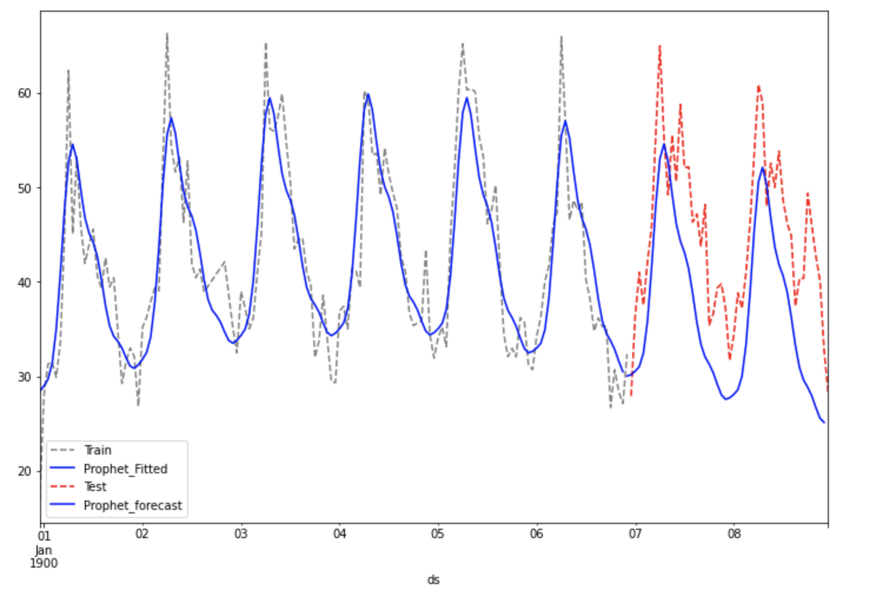
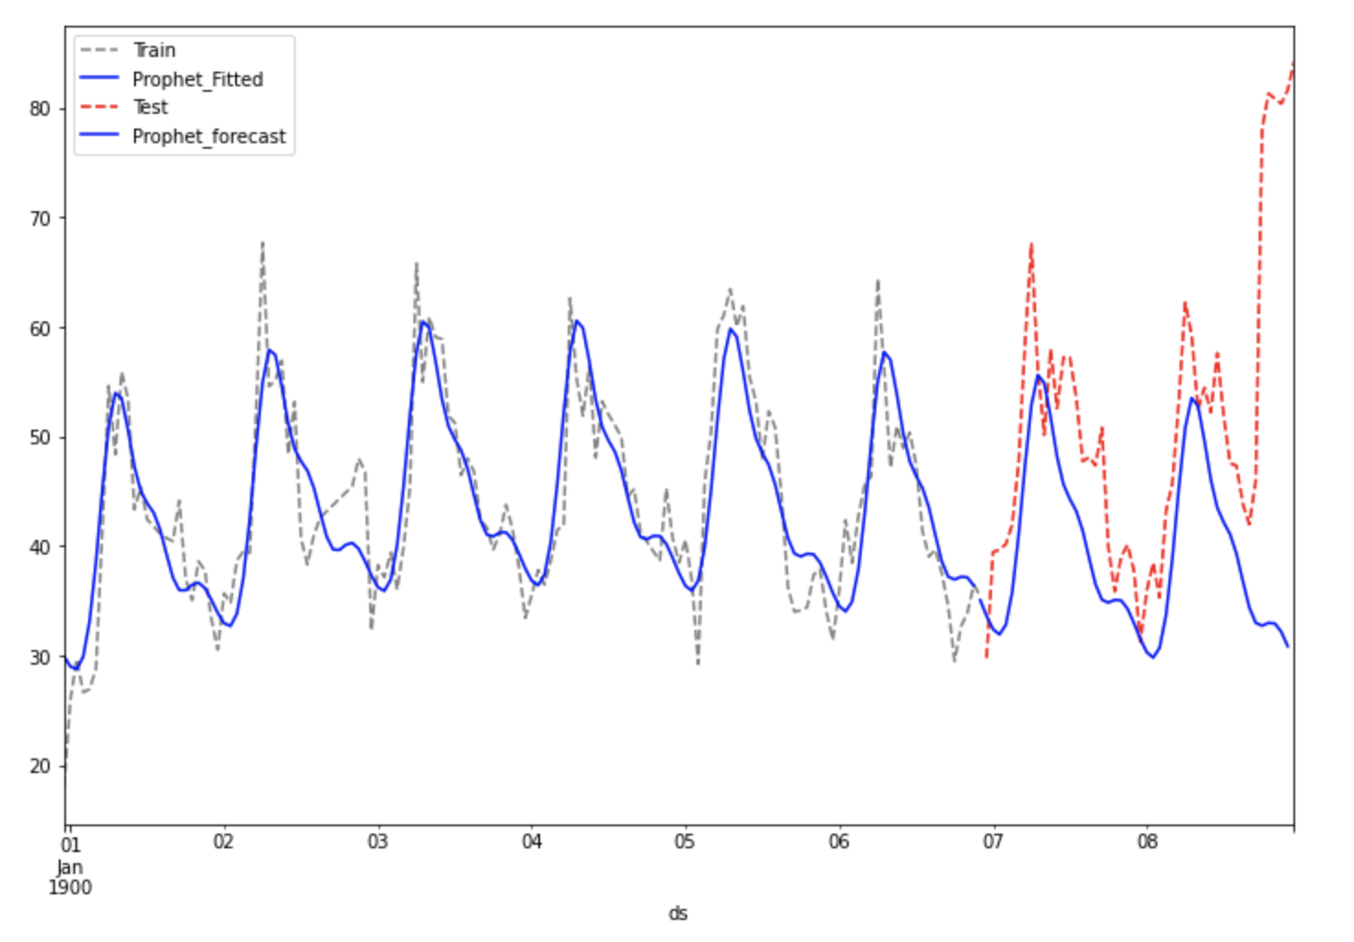
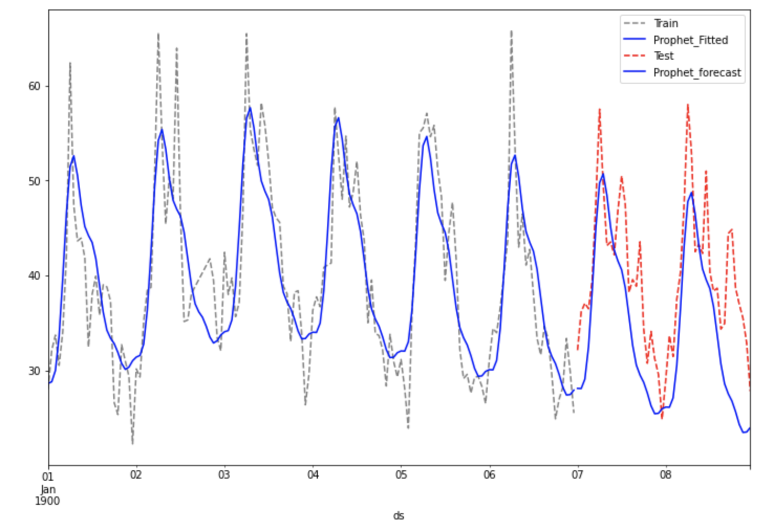
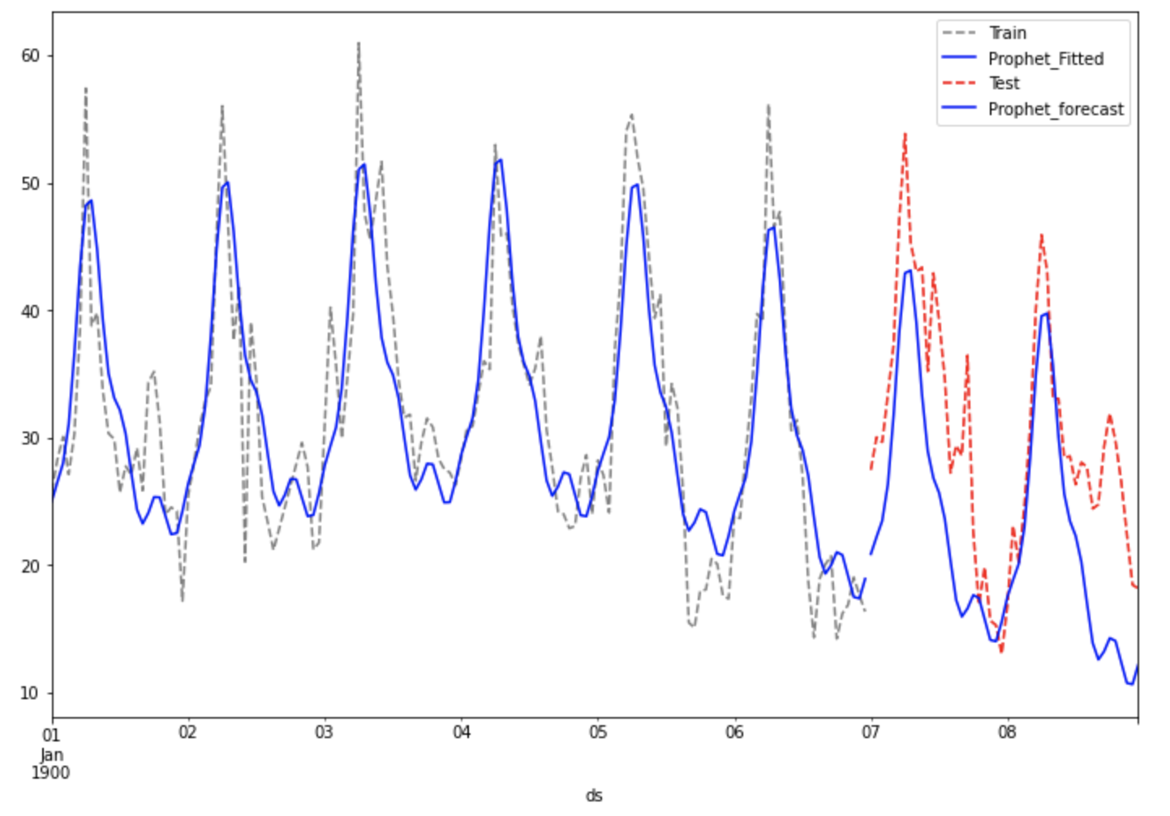
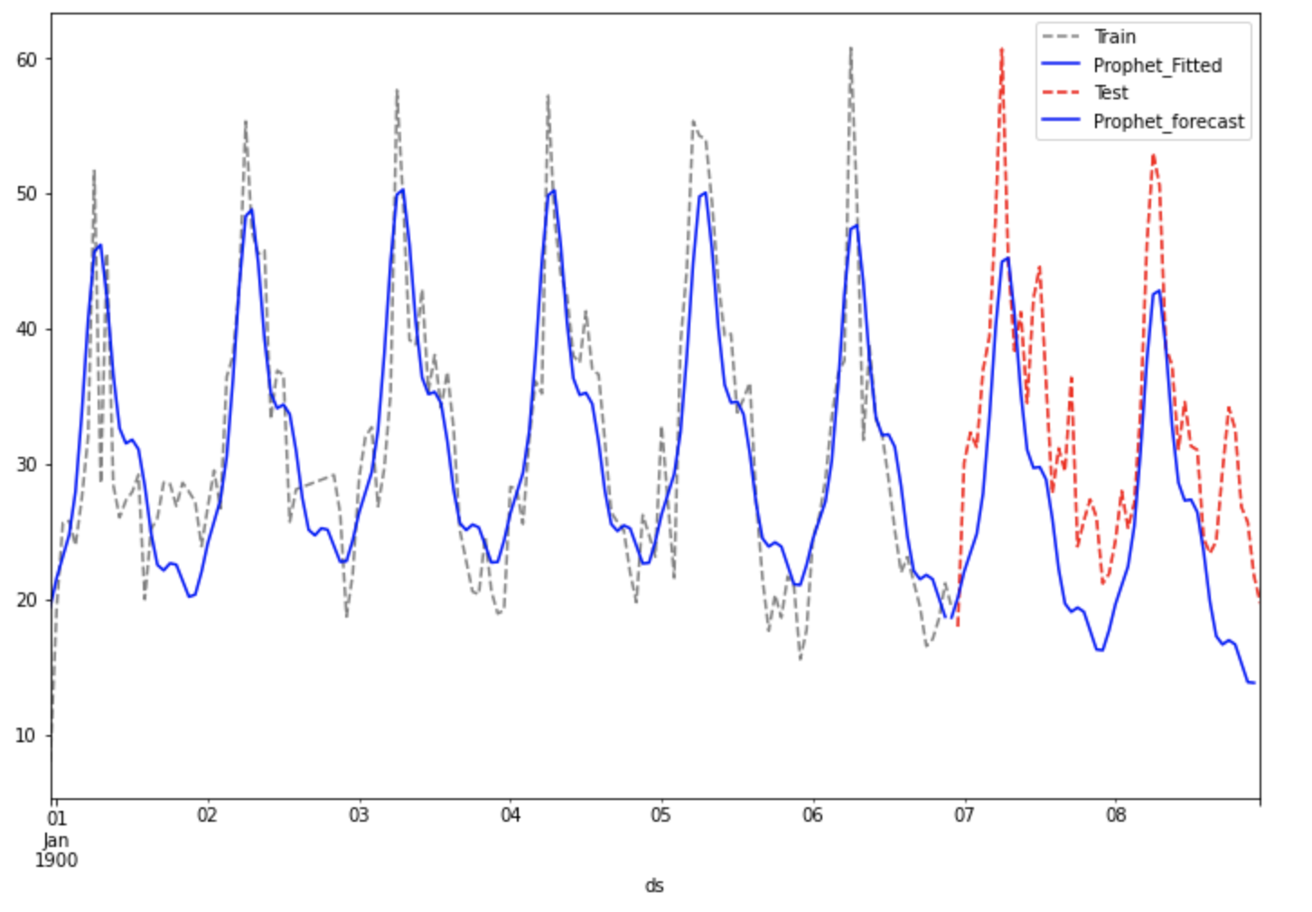
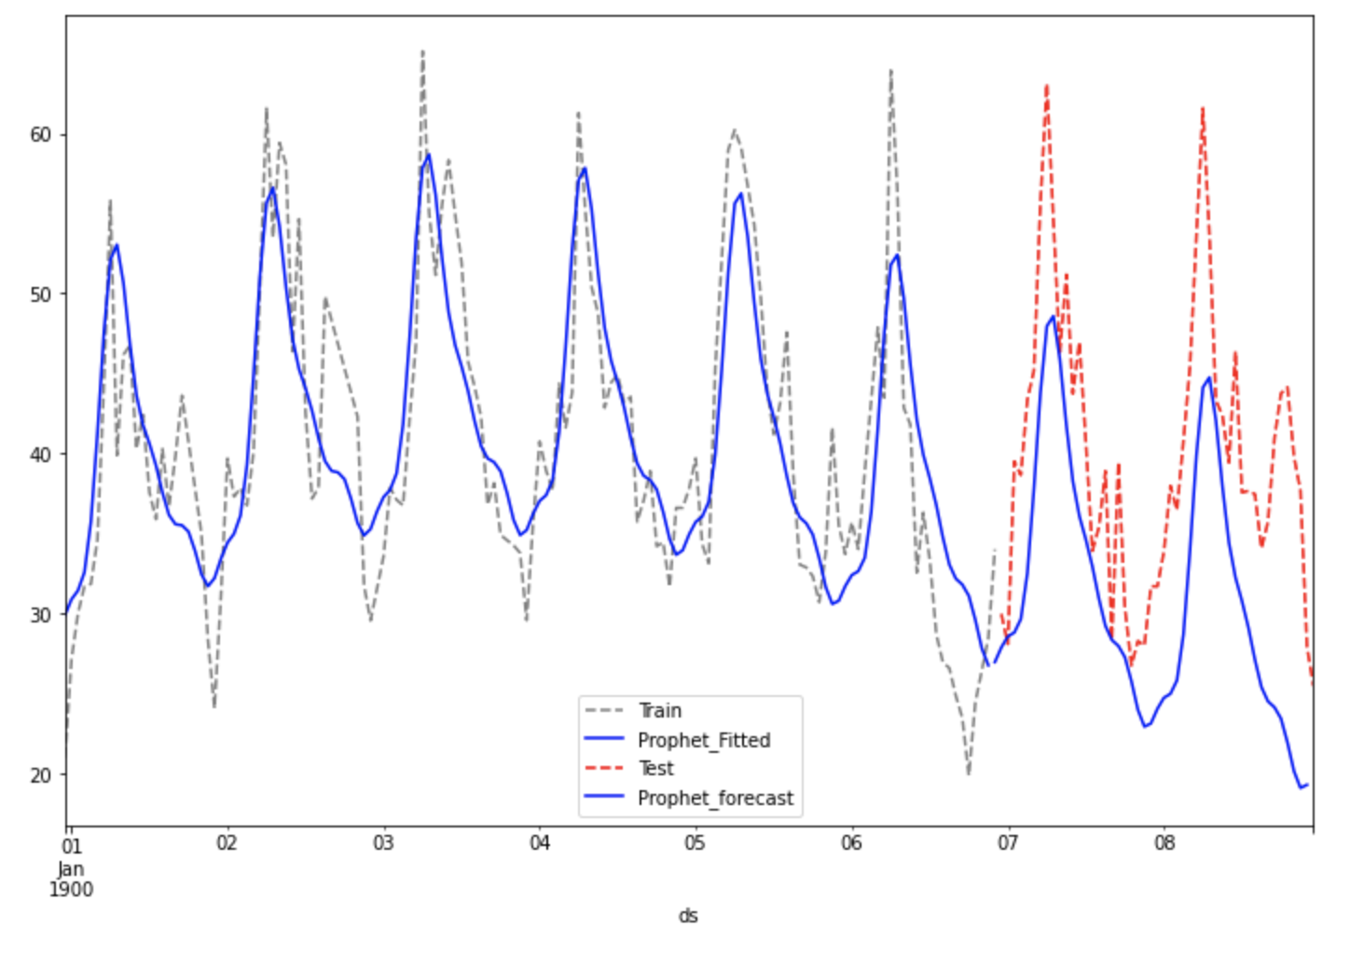
Prophet
Introduction ----- Problem ----- Solution ----- Models ----- Learning Path
Notes:
Lawrence - fast

Slide 21
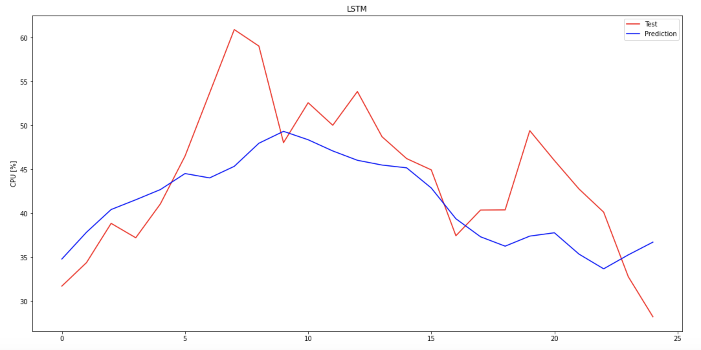
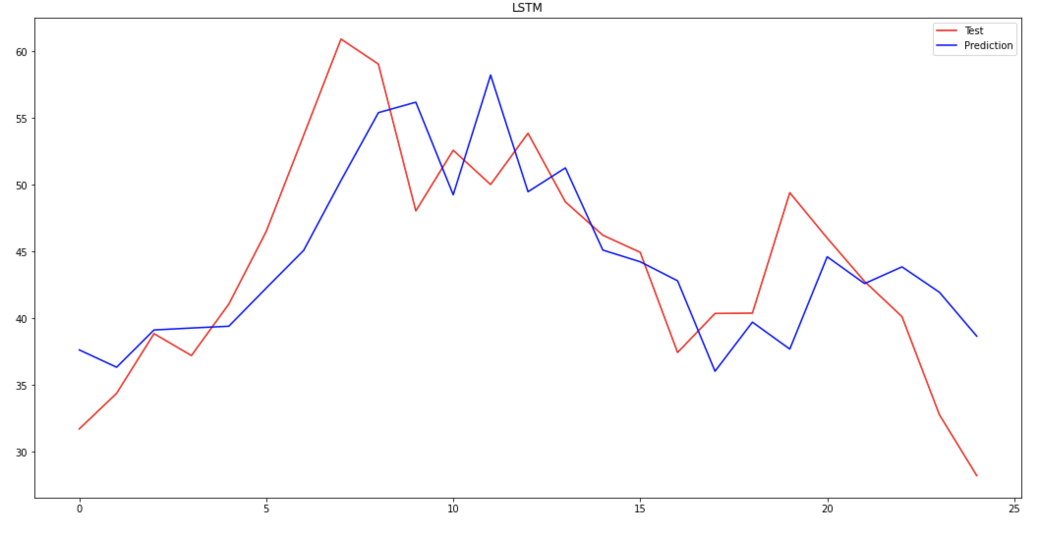
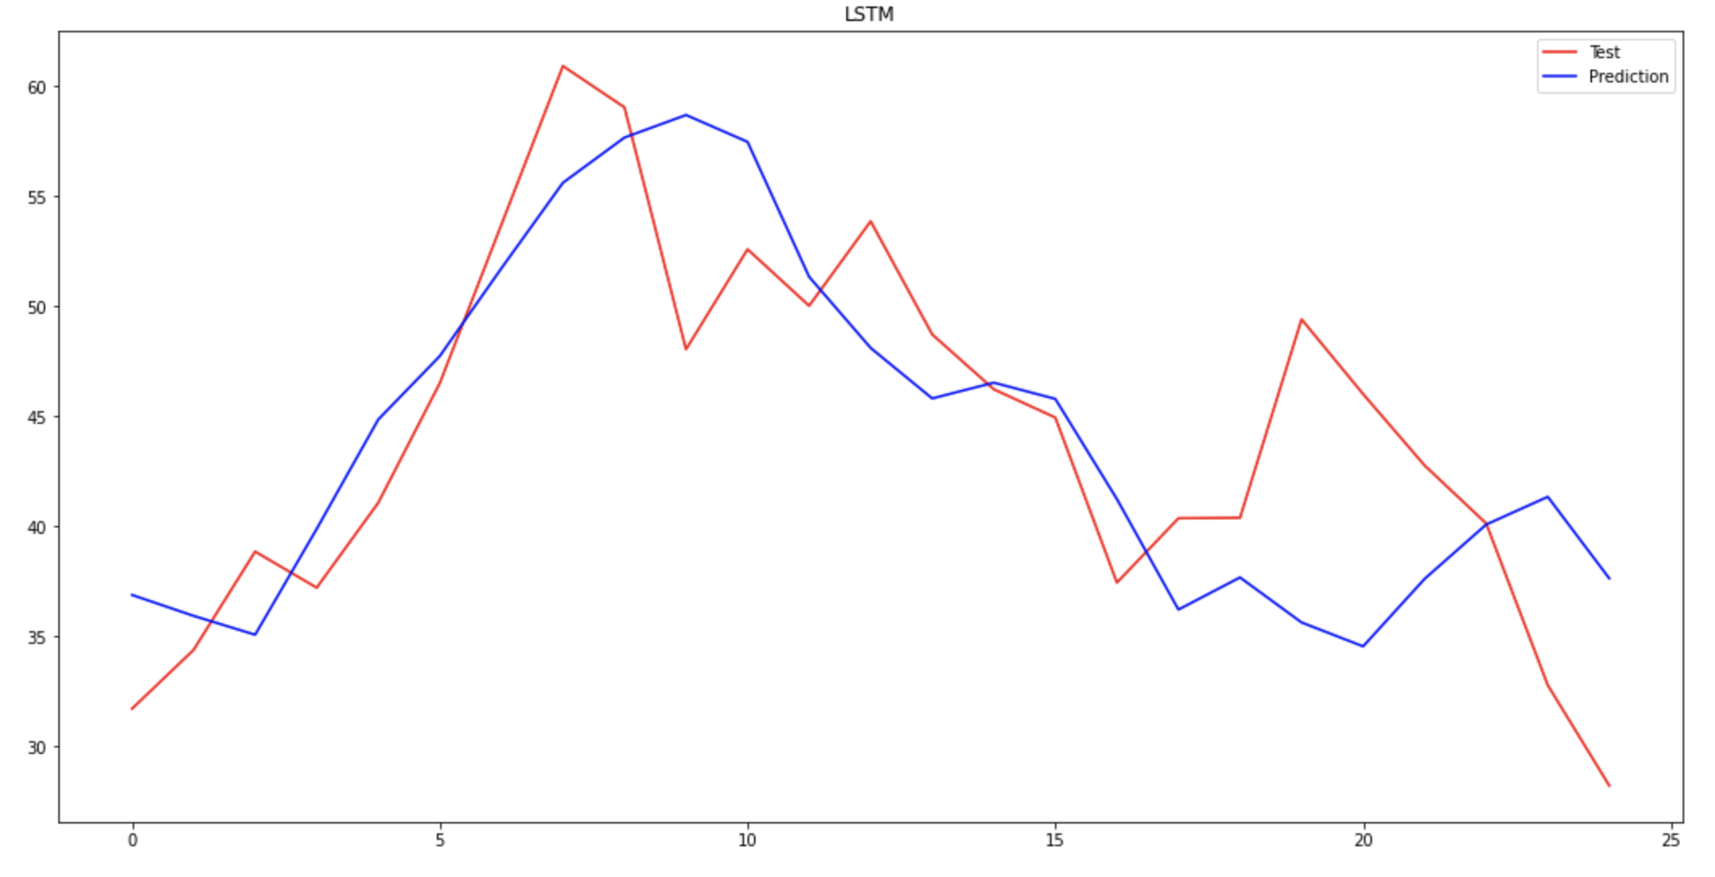
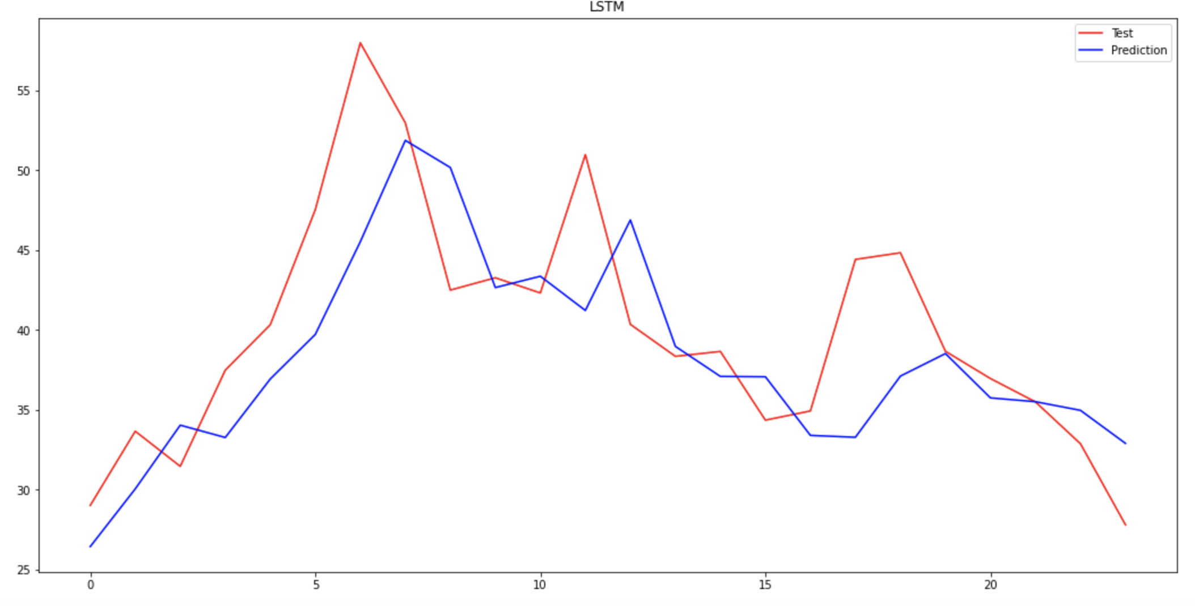
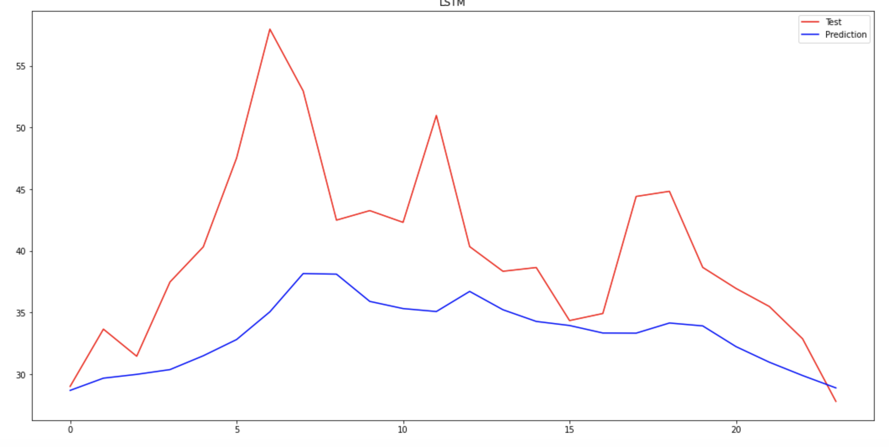
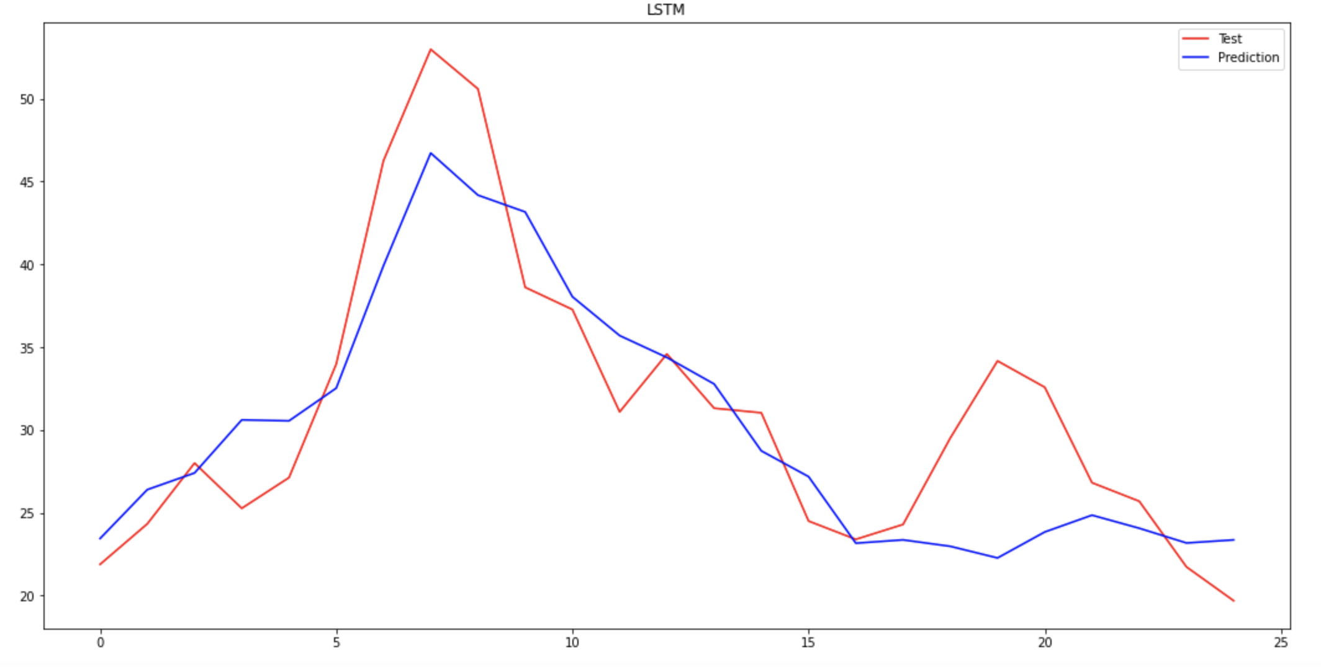
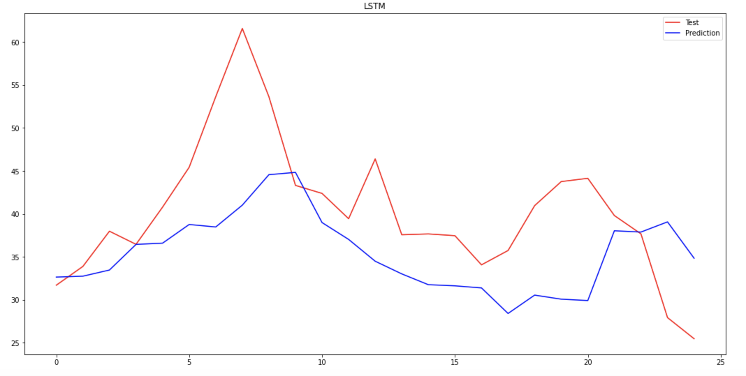
Long Short Term Memory (LSTM)
Introduction ----- Problem ----- Solution ----- Models ----- Learning Path
Notes:
Lawrence - fast

Slide 22
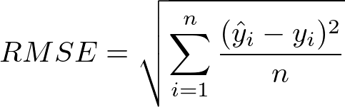
Comparing Models
SARIMA
Holt-Winter
Prophet
LSTM
 |  | RMSE
1 | SARIMA (1,1,2) (1,0,1) [24] | 8.12
2 | SARIMA (1,1,1) (1,0,1) [24] | 17.96
3 | SARIMA (3,1,2) (1,0,1) [24] | 5.25
4 | SARIMA (1,1,1) (2,0,0) [24] | 8.52
5 | SARIMA (0,1,1) (1,0,1) [24] | 6.62
6 | SARIMA (1,1,1) (2,0,0) [24] | 9.84
 |  | RMSE
1 | HW | 6.68
2 | HW | 17.00
3 | HW | 5.11
4 | HW | 6.53
5 | HW | 6.47
6 | HW | 6.62
 |  | RMSE
1 | Prophet | 9.60
2 | Prophet | 18.92
3 | Prophet | 7.43
4 | Prophet | 8.89
5 | Prophet | 9.17
6 | Prophet | 11.01
 |  | RMSE
1 | LSTM | 4.34
2 | LSTM | 9.55
3 | LSTM | 4.70
4 | LSTM | 4.46
5 | LSTM | 3.65
6 | LSTM | 4.65
Introduction ----- Problem ----- Solution ----- Models ----- Learning Path
Notes:
Robin
In order to defined the best model in statistical term, we use RMSE (Root mean square deviation) instead of MAPE due to the small value of data.
RMSE is the standard deviation of the residual (prediction errors) which the smaller the value leads the better prediction.
Therefore, by comparing each model’s RMSE value, the best model is LSTM.
.

Slide 23
Learning Path
01
02
03
04
05
Start
Brainstorming
Development
Solution
Learning and Future
Finding a dataset
Researching time series forecasting
Understanding the product and project objective
Time Series Forecasting
The Cyber Security and Compliance Industry
Teamwork during a Pandemic
Future Steps
Best implementation of models researched
Peak finding function
Testing different models
Exploring other datasets
Problems we encounter along the way
LSTM Model
Sarima model
FBProphet model
Holt-Winter Model
Introduction ----- Problem ----- Solution ----- Models ----- Learning Path
Notes:
Michael
Where we started: Our first objective was to find a dataset that closely resembled the output from an HSM device, then researching and understanding how to forecast for time series data, and then tying that into our objectives. Originally I would say about half of our group really understood time series forecasting so it was a great learning opportunity. Additionally, we had to do research into how HSM devices operate to get a better understanding of the goals of the project. After completing these tasks, we did a lot brainstorming and planning of the best models to utilize in order to complete our objectives and figure out the best ways to implement them.
Project Development: After initial planning we jumped right into testing our initial models and dataset. We ran into a few problems with fitting our models to our data due to high levels of variance and overall volume within our dataset, so we decided to explore some other datasets with lower variance and lower volume to test our models and then build out from there. Everyone on the team tested different models or using different parameters(Holt-Winter, triple exponential smoothing, lstm, Prophet, sarima). During this process we worked in a trial and error sort of fashion, slowly moving toward a model that best fit our overall objectives. We attempted to create a function to detect peaks in data but di We decided on the use of X________ that had the overall best performance.
What we learned and future: This project allowed us to research, explore and test a multitude of different time series forecasting methods and really develop our technical skill set in this area, along with furthering our abilities in data cleaning. Additionally, we were all able to gain an in-depth insight into the inner-workings of the Cyber Security and Compliance industry through understanding Utimaco’s product and business model in relation to their customers and their customers’ customers. Overall, I think we all gain valuable experience in collaboration, this was obviously a tough semester for all of us but I think we were all able to adapt to completely virtual environment, managing deadlines, scheduling meetings, and connecting online to create a successful project.
Future Steps: If we had more time we would have further refined our model by finding new datasets to test on, in addition to completing a peak-finding function we were working to implement. The next steps for Utimaco would be to implement our algorithm within Utimaco’s HSM user-interface and begin feeding in product data. Looking back on the project as a whole, if we could do it over again I think we would have attempted to complete our peakfinding function(expand?) and utilize that within our models to offer more accurate predictions, as well as more extensive research in an accurate dataset that we could use throughout.

Slide 24
Thanks!
Any questions?

